Slide 1


Intro to Git
Basics,setup and how to

Slide 2
Overview
Brief overview and history of Git
Intro to problems solved by source control
Basic Git commands and workflow (add, commit, and push)
Overview of expanded ideas (clone, merging and conflicts, branching)
Practical examples
Setup of GitHub app
Hands on experience

Slide 3
What is Git?
Git is a source control system.
What is source control
“…is the management of changes to documents, computer programs, large web sites, and other collections of information”. –Wikipedia
Source control is also called version control and revision control.
Older source control methods allowed users to check out a file from a file server, but that file become locked while it was checked out. This prevented 2 developers from modifying the same file at the same time.

Slide 4
What is Git ?
Git was invented by Linus Torvalds (inventor of Linux)
Prior to 2005, the Linux community used BitKeeper as their source control tool. BitKeeper was stopped being free to use. This prompted the Linux community to make their own source control tool.

Slide 5
Coding without source control
In the past, you’ve probably written code or some other type of project and saved it to a flash drive.
If the project stayed on your flashdrive. Changes were pretty straightforward. As soon as you copied the project to another machine or got another person involved, changes became more tedious.
There is a good chance you lost track of which copy of the project was the most recent. If your partner made changes, you would also have to rectify those changes.

Slide 6
Basic git commands and workflow
git status
This is a basic command where the shell will tell you the current state of your local repository. As a part of git workflow, this should be frequently used before other commands.
git add –A
This is the first step in sending an update to git. If allows git to locally see your changes. Any files added to the project are now visible to git (but only locally). When you use git add –A, any new files added to the project become tracked.

Slide 7
Basic git commands and workflow
git commit –m “your message here”
The commit is a major concept in git. It is a save point by which the code for the entire project can be defined. Your repository is ultimately a large stack of commits. The power of git comes from being able to accept, revoke, merge and pull back commits.
Every commit requires a message, it will be a brief description of what changes are in your commit. Each commit also has a unique ID.
git push
This is the command that will add your commit(s) to the repository, making your local changes apart of the remote repository. More simply put, it sends your commit into the cloud.

Slide 8
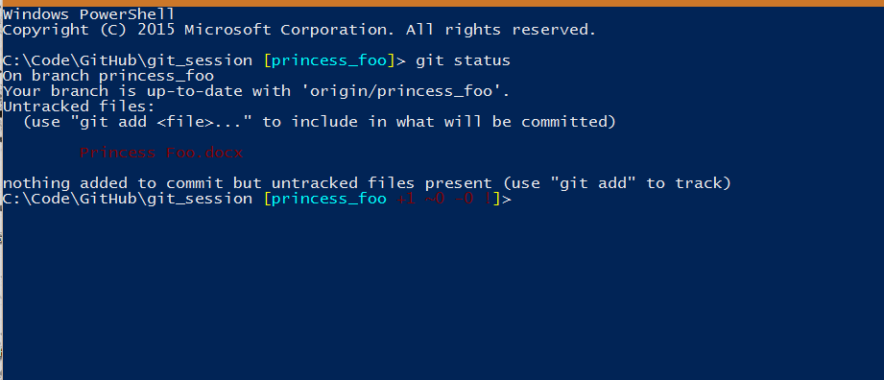
Examples of basic Git commands
Repository already contains a text file version of Princess Foo. Examples show addition of .docx version of the same text.

Slide 9
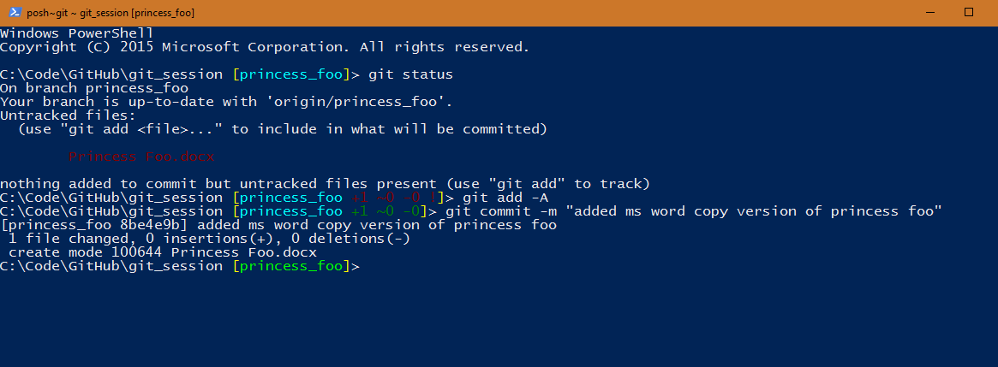
Examples of basic git commands
With the .docx version added, we can make a commit for it. Is it worth committing here?

Slide 10
Examples of basic Git commands
Once we have a commit, we can push or we can add more commits.

Slide 11
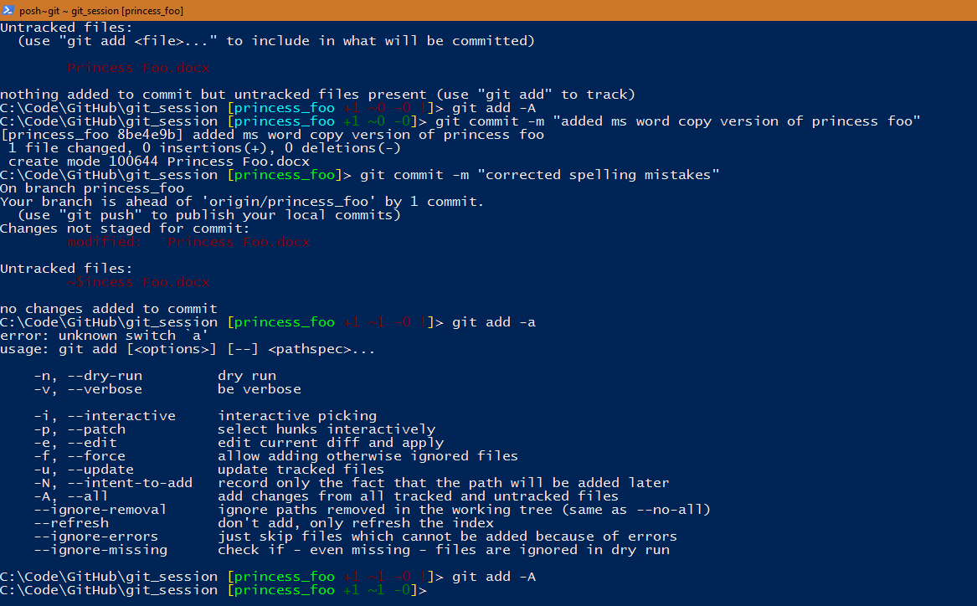

Slide 12
Examples of basic Git commands
When we feel compelled that our changes should be added to the remote repository, we push our commit(s).

Slide 13
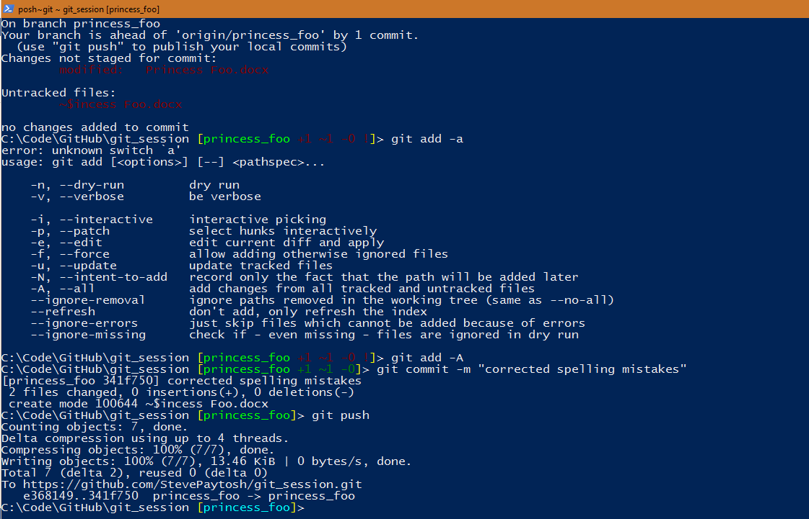

Slide 14
Intermediate Git commands
Add, commit and push are the basics commands of Git and represent just the bare minimum needed to use Git.
Branching
Code can be branched off, so that changes on one branch do not effect another branch. This is useful for adding new functionality or attempting to debug a major problem without destroying your current version of code.
git pull
This command brings down any changes to from the remote repository and adds it to the local repository. Be aware of merge conflicts here.
Cloning:
This is the act of pulling down an existing repository. This can be more easily done using the GitHub app.

Slide 15
Intermediate Git commands
Branching:
git checkout <branch name>
git checkout lets you traverse between branches. When you switch branches, the code in your folders will change automatically.
git checkout –b <branch name>
This command lets you create a new branch on your machine. When you create the new branch, it will automatically jump to the new branch.
git push –set-upstream origin <branch you are appending to>
When you create your branch, the remote repository doesn’t know about it. So we have to push the new branch to the remote repository. You’ll notice it says master at the end,.

Slide 16
Intermediate Git commands
git pull
Pull is more of a basic git command, but isn’t required. Pull is the opposite idea of push, think pulling something down. Pull simply updates your local repository based on what's in the remote repository. So if your team-mate tells you that they just pushed an update, you’ll want to run git pull.
Merge conflicts are disagreements in content based on the line of code. If user A changes a particular line, and user B pushes up a change to the same line, user A will encounter a merge conflict when pulling the changes made by user B.
It is worth noting that git pull is actually 2 commands in 1. It does the work of both git fetch and git merge.

Slide 17
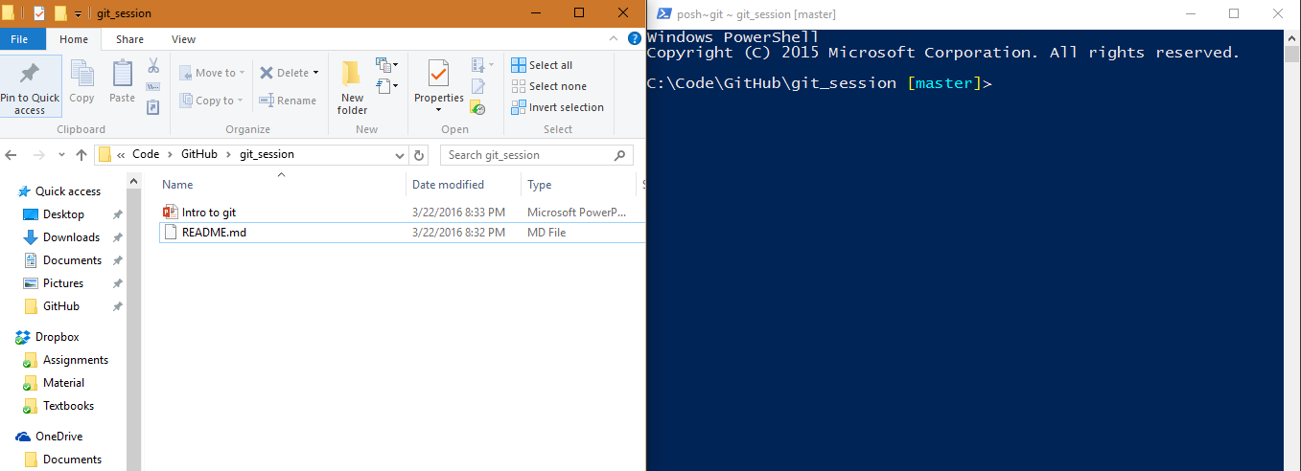
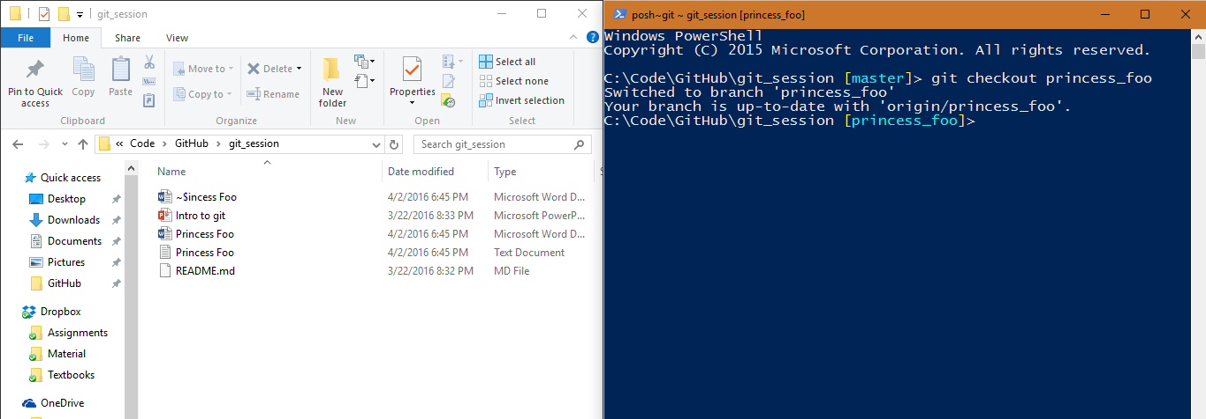
These two images demonstrate that the content of your files physically changes when you switch branches.

